Slide 1

Stack Overflow Insights
By: Jerry Trieu & Ocean Lu
Notes:
Team info and project title

Slide 2
Problem Statement & Dataset
Stack Overflow’s annual Developer Survey is the largest and most comprehensive survey of people who code around the world. It surveys everything from developers’ favorite technologies to their job preferences.
survey_results_public.csv - CSV file with main survey results, one respondent per row and one column per answer (191.986 MB > 1 MB)
The enclosed data set is the full, cleaned results of the 2019 Stack Overflow Developer Survey. Free response submissions and personally identifying information have been removed from the results to protect the privacy of respondents.
Notes:
Size and basic info about the data set (from README_2019)

Slide 3
Problem Statement & Dataset
What are the top languages used?
What are the top developer roles?
What is the average age of users?
What is the student population and how many of us code for fun?
What is the gender diversity in the coding community?
Nearly 90,000 developers answers on how they learn, which tools they’re using, and what they want, we examines large amounts of data to uncover hidden patterns, correlations and insights and want to see what kind of inclusion and diversity is in the coding community.
Notes:
What specific problem/field are you addressing? [assignment:]
Design at least 10 questions that you could answer by analyzing the big data set. (see lecture explanation.)

Slide 4
Problem Statement & Dataset
Data set citation: https://insights.stackoverflow.com/survey/2019
Previous survey results: https://insights.stackoverflow.com/survey
This database - The Public 2019 Stack Overflow Developer Survey Results - is made available under the Open Database License (ODbL): http://opendatacommons.org/licenses/odbl/1.0/. Any rights in individual contents of the database are licensed under the Database Contents License: http://opendatacommons.org/licenses/dbcl/1.0/
Notes:
Where did you get the data set?

Slide 5
Tools & Platform
Google colab is a cloud based data science work space similar to the Jupyter notebook. Each colab session is equipped with a virtual machine running 13 GB of ram and either a CPU, GPU, or TPU processor.
Google Colab view only link: https://colab.research.google.com/drive/1iakJLmnH-wAgkOUHZiCl426C7O0vuJqc
Notes:
Tools and platform (e.g. Pandas, Google Colab, …) used for analysis

Slide 6
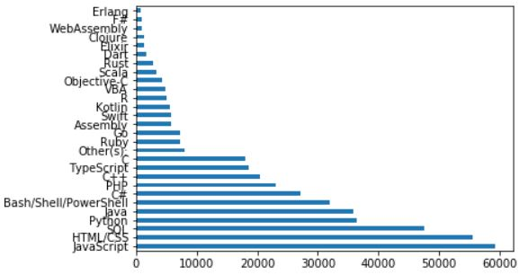
Analysis Results: Top Languages
What are the top languages used?
Languages
Amount of Respondents

Slide 7
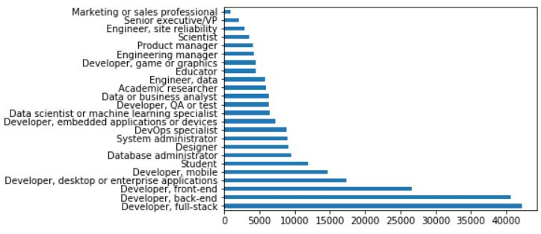
Analysis Results: Top Developer Roles
What are the top developer roles?
Developer Types
Amount of Respondents

Slide 8
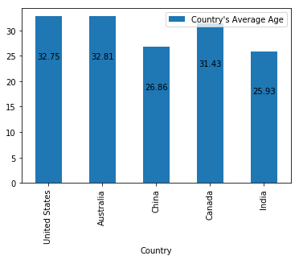
Analysis Results: Average Age per Country
Age

Slide 9
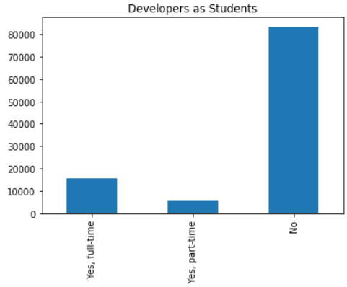
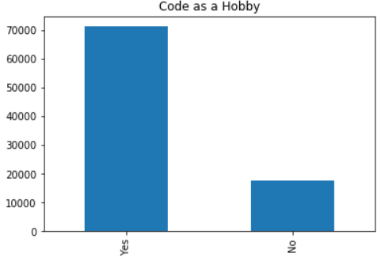
Analysis Results: Students & Hobbies
What is the student population and how many of us code for fun?
Respondents
Respondents

Slide 10
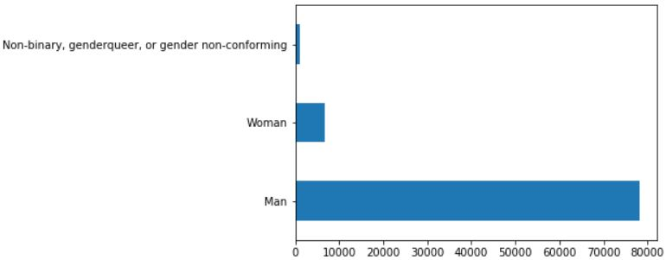
Analysis Results: Gender
What is the gender diversity in the coding community?
Gender
Amount of Respondents

Slide 11
Thank you for listening!

